Slide 1
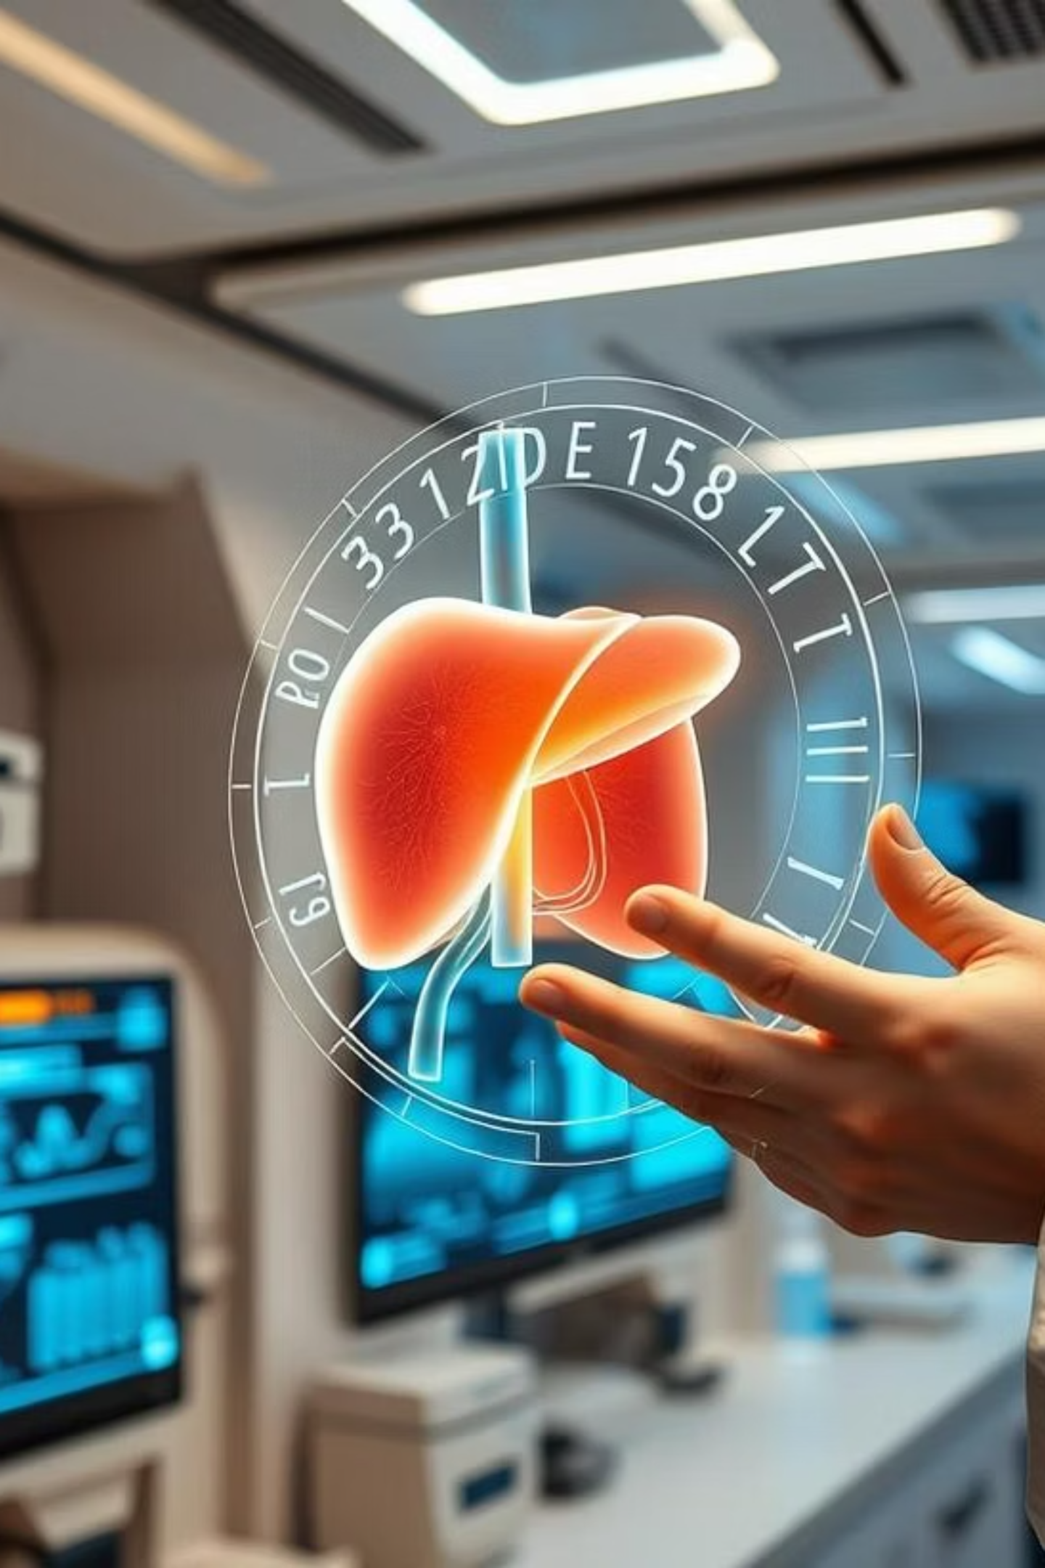
Liver Cirrhosis Prediction: A Machine Learning Approach
Exploring how advanced machine learning techniques can revolutionize the early detection and prediction of liver cirrhosis, offering new hope for improved patient outcomes.

Slide 2
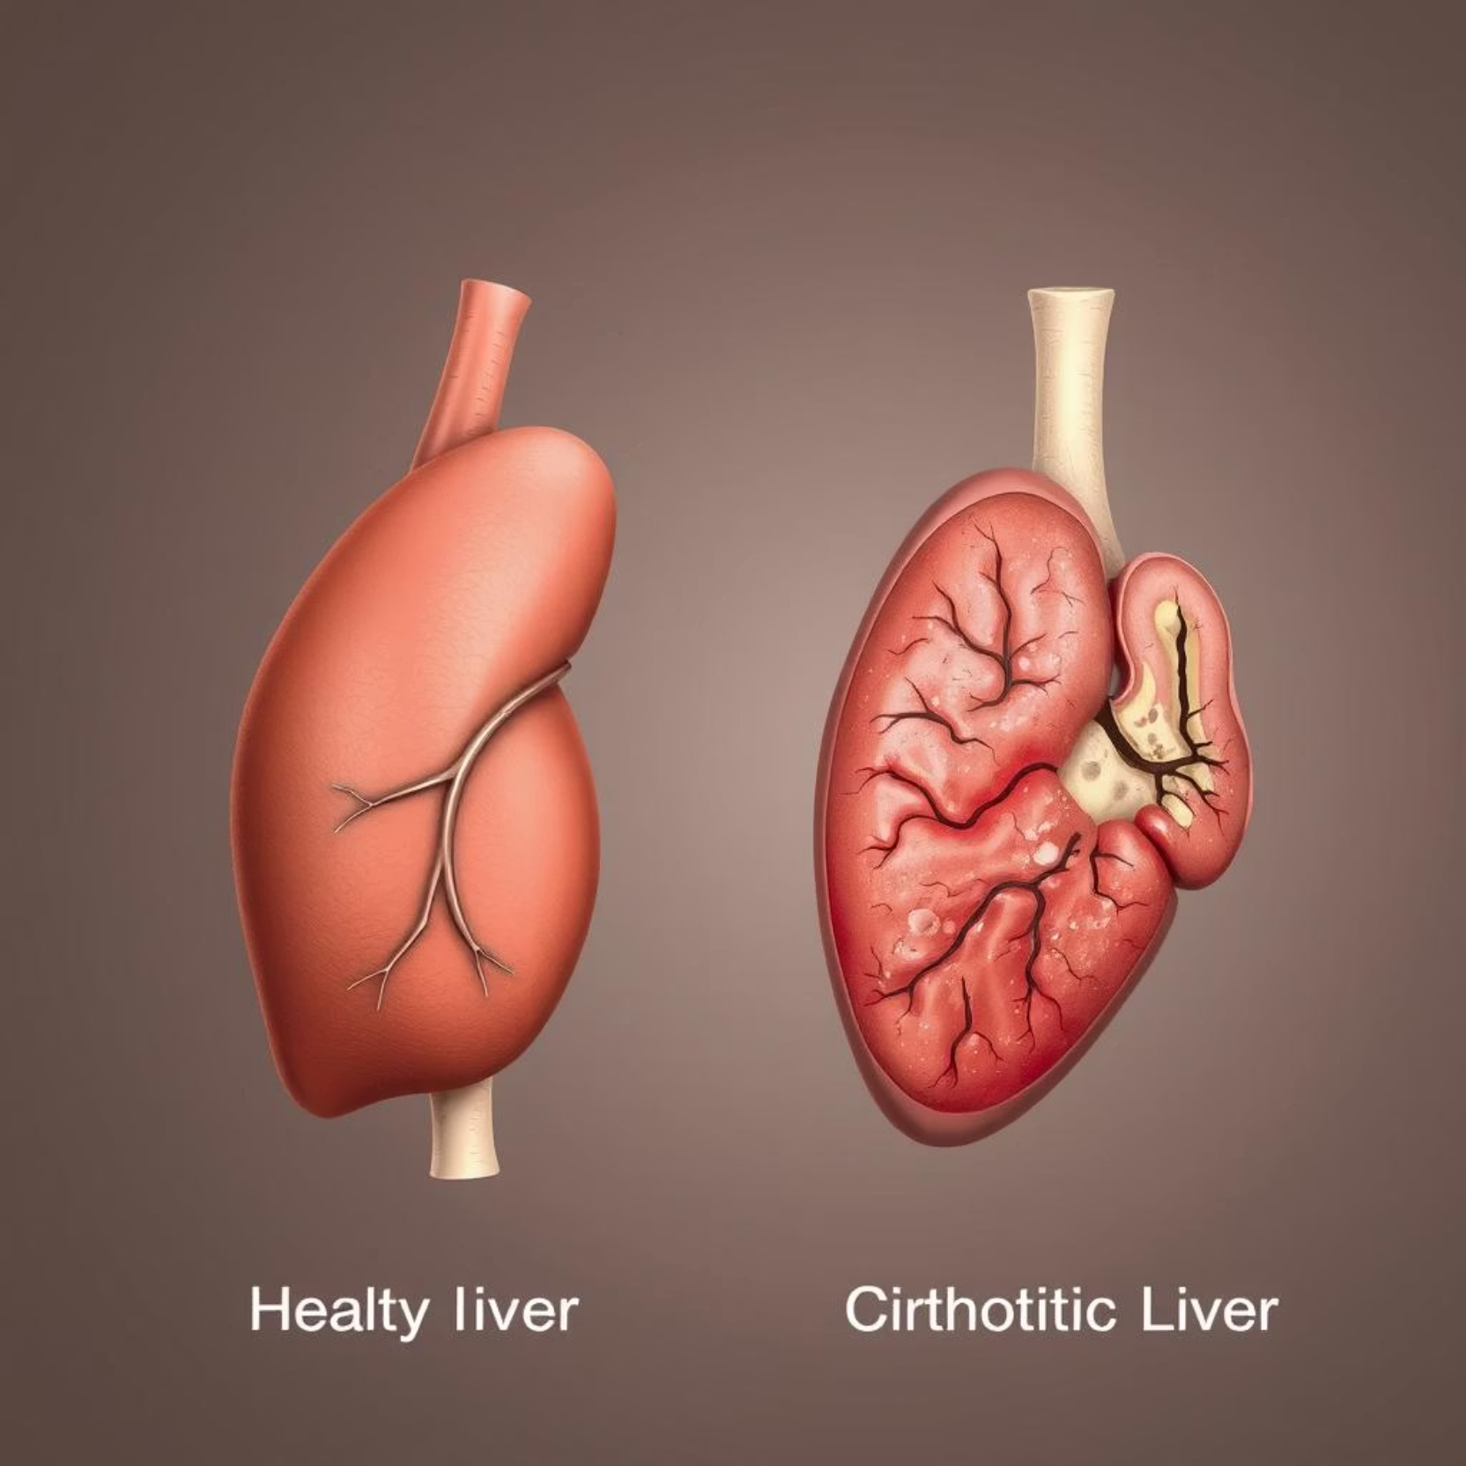
The Silent Threat: Understanding Liver Cirrhosis
Liver cirrhosis is a late-stage scarring of the liver caused by various liver diseases and conditions, such as hepatitis and chronic alcoholism. This progressive condition often develops silently over many years, with symptoms only appearing in advanced stages.
Early detection is crucial because, in its initial stages, the liver can regenerate. However, once significant scarring occurs, the damage is largely irreversible, leading to severe complications like liver failure, portal hypertension, and liver cancer.

Slide 3
Current Diagnostic Challenges & Unmet Needs
Invasive Procedures
Late Diagnosis
Subjectivity in Interpretation
Traditional diagnostic methods, like liver biopsies, are invasive, painful, and carry risks for patients. They also provide only a snapshot of the liver's condition.
Many patients are diagnosed when the disease is already advanced, limiting treatment options and leading to poorer prognoses.
Some diagnostic tests rely on subjective interpretation, potentially leading to inconsistencies and delayed intervention.
There's an urgent need for non-invasive, accurate, and early detection methods to improve patient management and outcomes in liver cirrhosis.

Slide 4




Why Machine Learning? Bridging the Prediction Gap
Pattern Recognition
Enhanced Accuracy
Machine learning algorithms excel at identifying subtle patterns and complex relationships within large datasets that are often missed by human analysis.
By analyzing numerous risk factors and biomarkers simultaneously, ML models can provide more accurate and timely predictions of cirrhosis development.
Efficiency & Speed
Personalized Risk Assessment
ML models can process vast amounts of patient data rapidly, providing quick insights for clinical decision-making.
Tailor-made predictions based on individual patient profiles enable proactive and personalized intervention strategies.

Slide 5
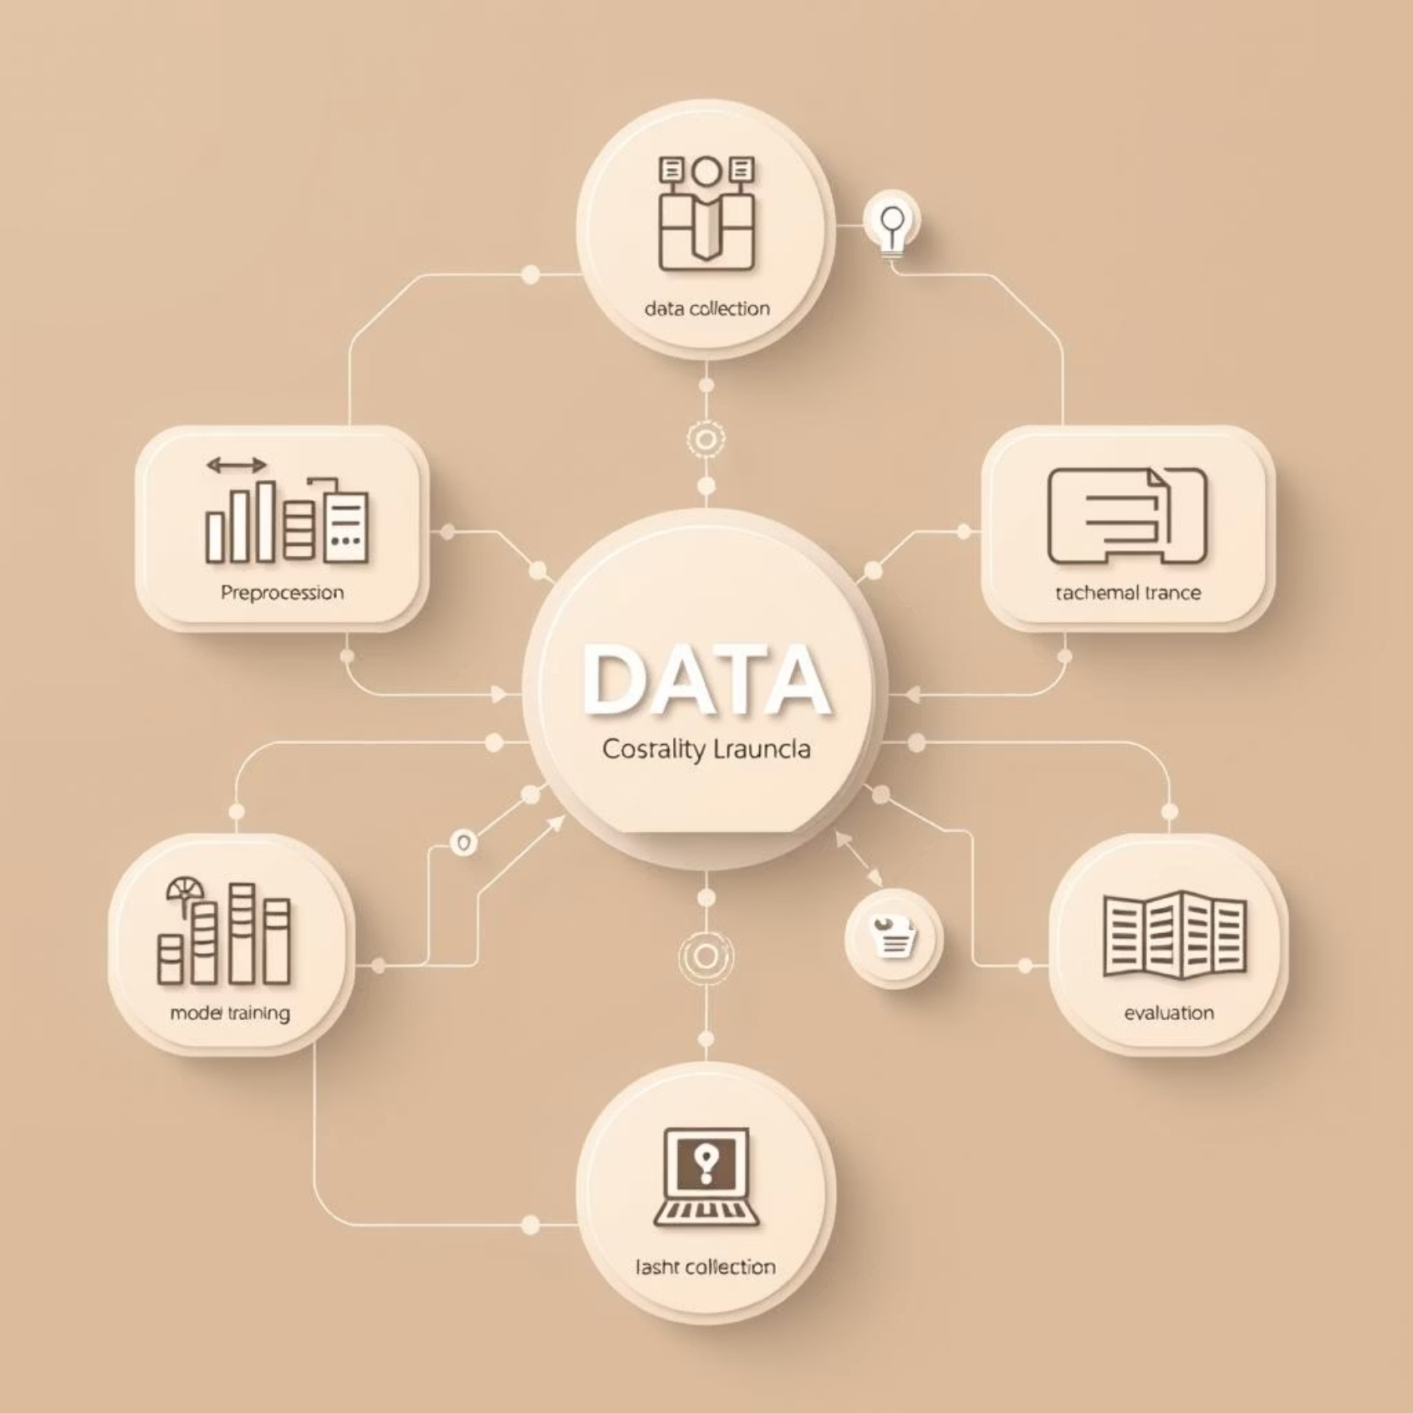




Data & Methodology: Building Our Predictive Models
Our models leverage comprehensive patient datasets, including clinical lab results, demographic information, and medical history. Key features like albumin, bilirubin, prothrombin time, and platelet count are crucial.
Data Collection
Aggregating anonymized patient data from electronic health records.
Feature Engineering
Selecting and transforming relevant clinical and demographic variables.
Model Training
Utilizing algorithms like Random Forest and Gradient Boosting on the prepared data.
Validation
Rigorous testing and cross-validation to ensure model robustness and generalizability.

Slide 6
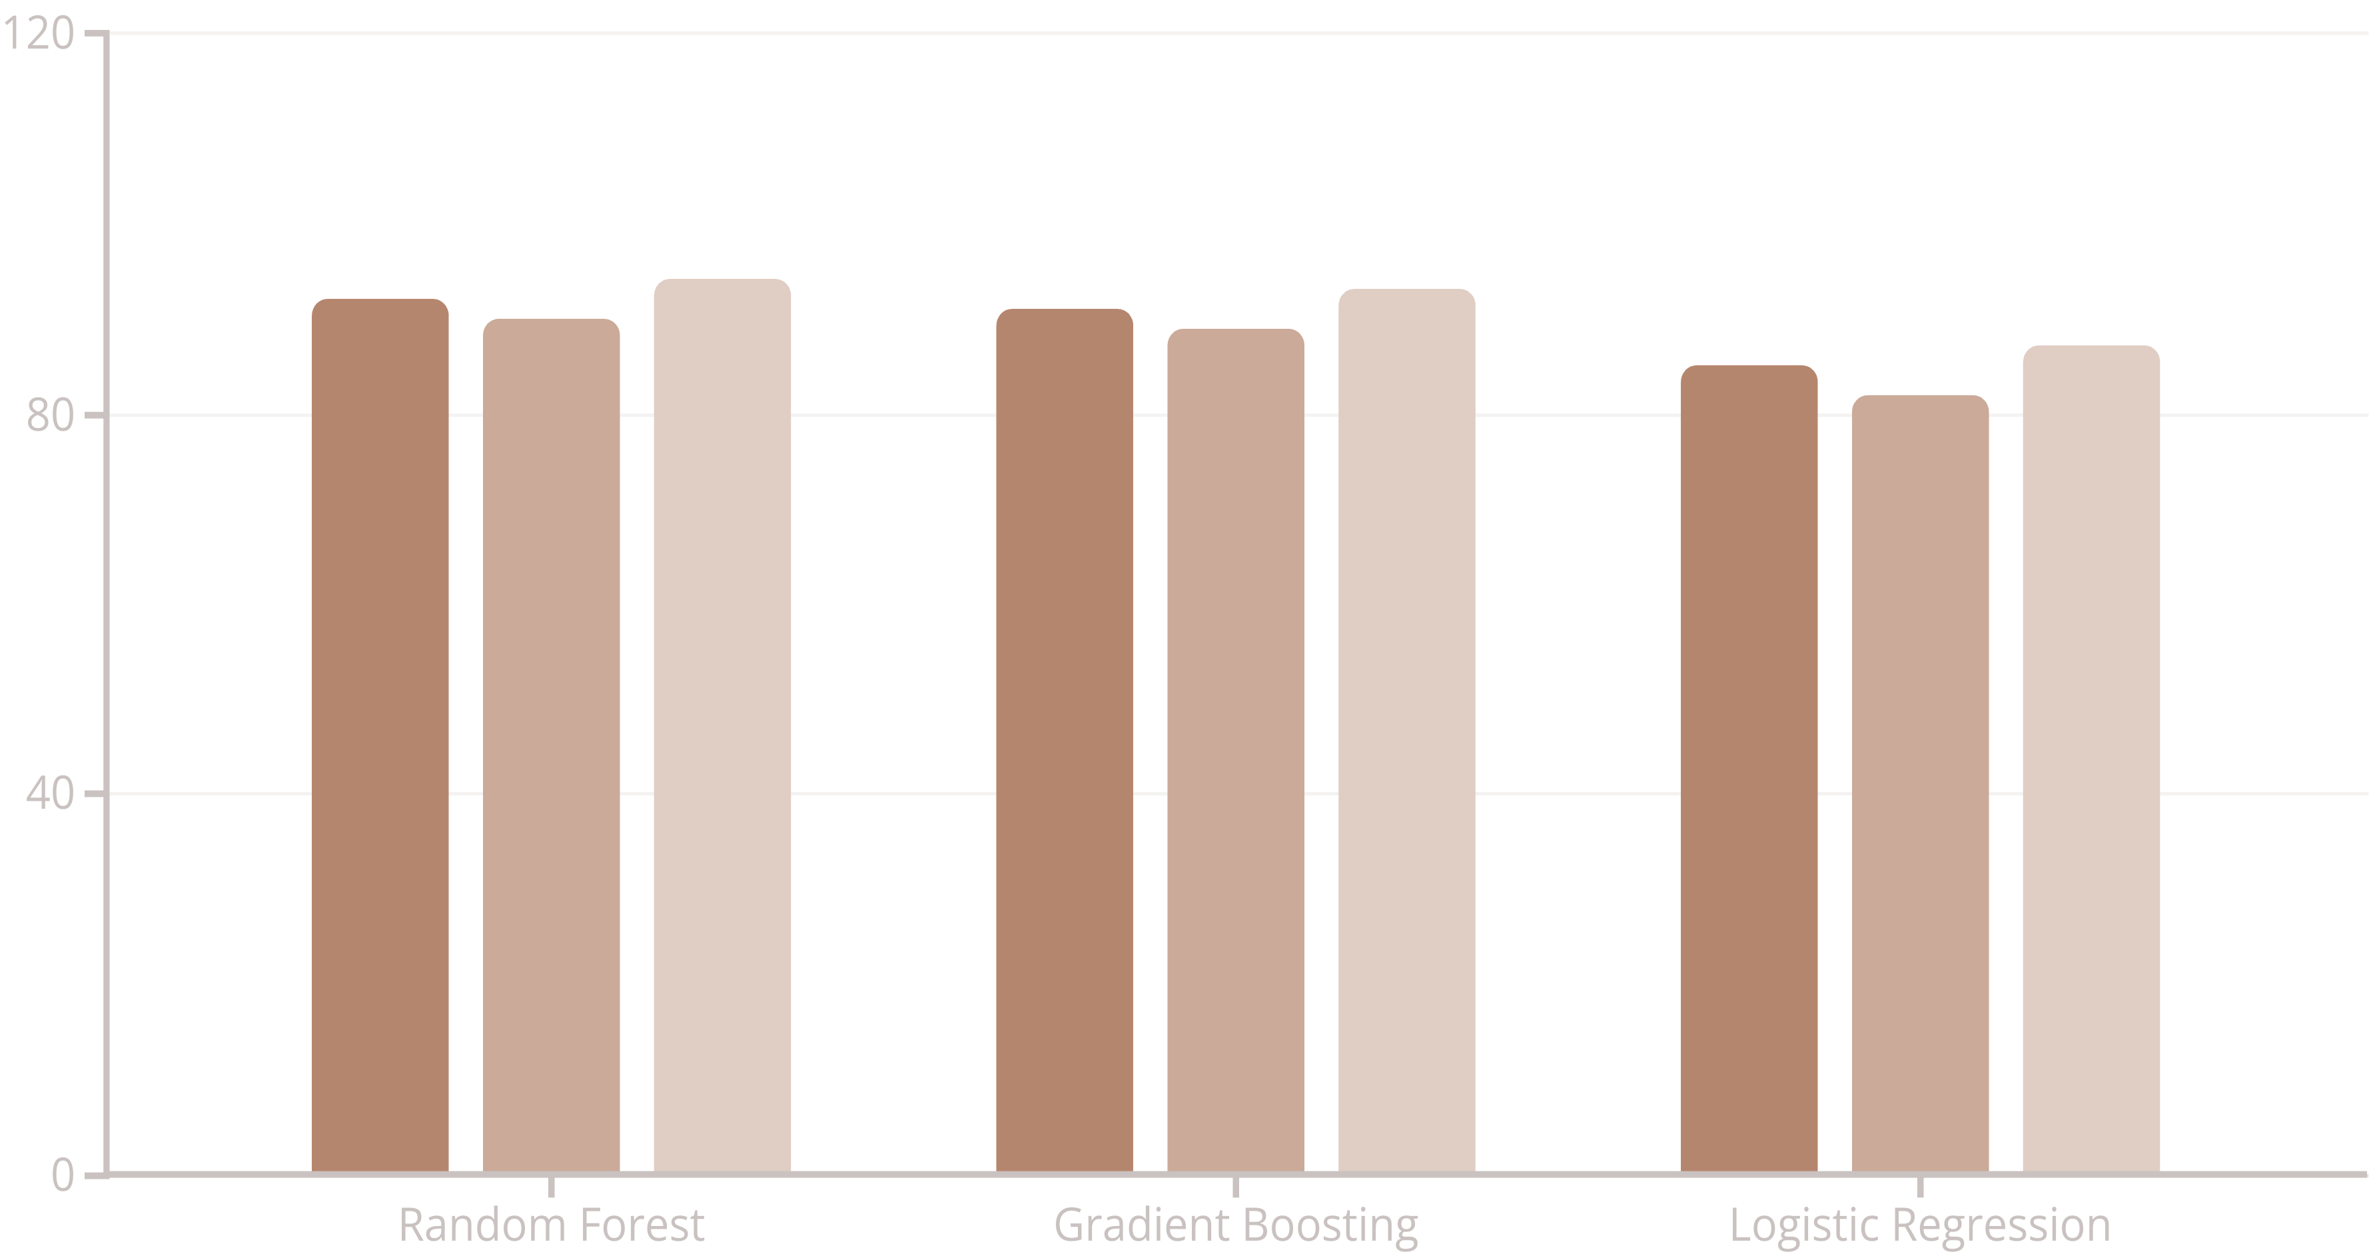
Unveiling Insights: Model Performance & Key Predictors
Our machine learning models demonstrate high accuracy in predicting liver cirrhosis, significantly outperforming traditional methods.
Accuracy (%)
Precision (%)
Recall (%)
Key predictors identified by the models include patient age, albumin levels, bilirubin levels, and prothrombin time, confirming their critical roles in liver health assessment.

Slide 7
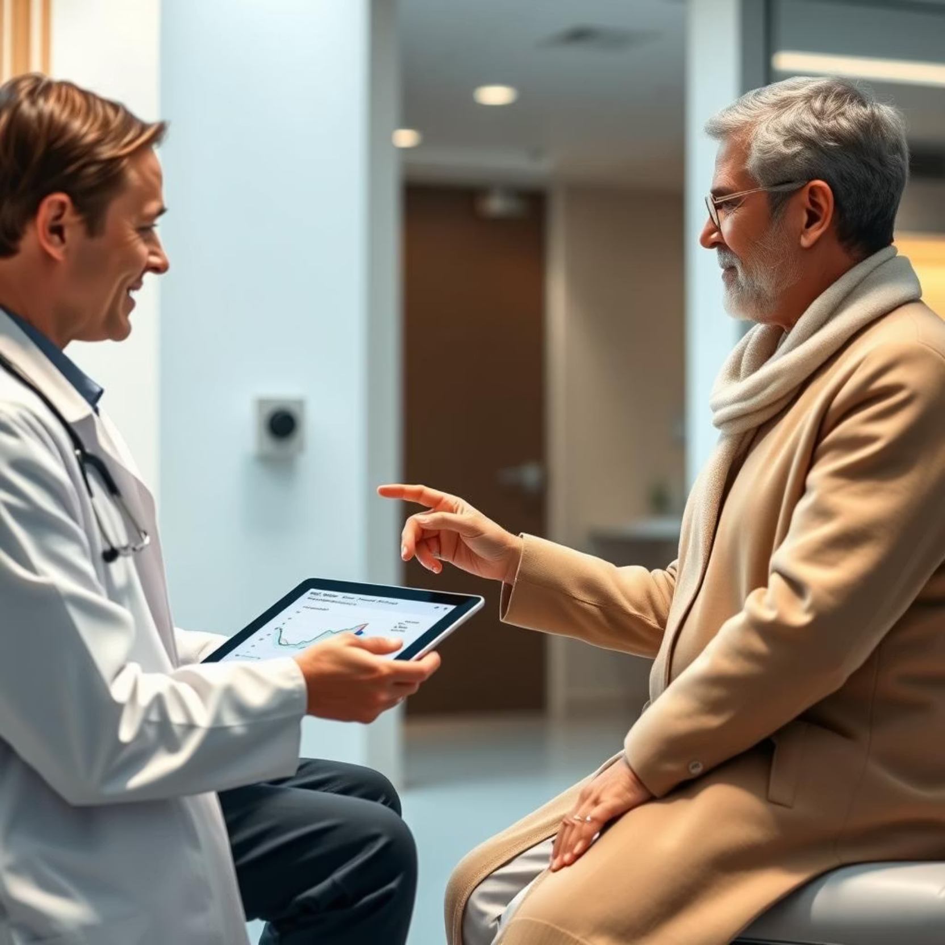
Clinical Impact & Real-World Application
Early Intervention
Enable clinicians to identify high-risk patients much earlier, allowing for timely lifestyle modifications or medical treatments to slow or prevent disease progression.
Reduced Burden
Decrease the need for invasive diagnostic procedures, improving patient comfort and reducing healthcare costs.
Personalized Medicine
Facilitate a more personalized approach to patient care by providing risk stratification tailored to individual profiles.

Slide 8
Revolutionizing Early Detection: Key Takeaways & Future Work
Improved Patient Outcomes
Machine Learning for Cirrhosis
Early detection means timely intervention, potentially preventing irreversible liver damage and severe complications.
A powerful tool for early and accurate prediction of liver cirrhosis, moving beyond traditional diagnostic limitations.
Collaborative Research
Future Directions
Ongoing partnerships with clinicians and researchers are crucial to refine and deploy these predictive models effectively.
Integration with real-time EHR data, external validation with diverse populations, and exploring explainable AI for clinical trust.

